Slide 1
Brightness-Aware Dynamic
DDIM Step Scheduling
for Efficient Low-Light Image Enhancement
Janhavi P. Tidke¹ · Ramesh Kumar Thakur² · Shashank Gupta³ · Tanveer Fatema Khan³
¹ NIELIT Aurangabad ² ³ MANIT Bhopal

Slide 2



INTRODUCTION
Why Low-Light Image Enhancement Matters
The Problem
Real-World Impact
Diffusion Approach
Images taken in poor lighting suffer from low contrast, colour distortion, and noise — difficult to interpret manually or algorithmically.
Night driving, surveillance, and mobile photography are safety-critical applications where lighting conditions are uncontrollable.
Unlike GAN-based one-shot methods, diffusion models restore images step-by-step — producing sharper texture and structure.
2

Slide 3
BACKGROUND
From DDPM to DDIM: A Quick Primer
01
Forward Process (DDPM)
02
Reverse — DDPM
03
Reverse — DDIM
A clean image is gradually corrupted with Gaussian noise over T steps until it becomes pure noise.
A network learns to predict and remove noise step-by-step. Stochastic, needs hundreds-to-thousands of steps.
Same trained network, deterministic reverse process — allows skipping steps with equal quality, typically 5–50 steps.
4

Slide 4
BACKGROUND
DLDiff: The Model We Build On
DLDiff extends Latent Diffusion Models (LDM) for low-light enhancement with two key additions:
VQGAN Latent Space
Detail Prompt Module
Content-aware Loss Group
Compresses image from pixel space to compact latent representation
Reduces compute cost vs pixel-space diffusion
Encoder E compresses; Decoder D reconstructs at the end
Laplacian sharpening → edges highlighted
Hybrid Attention Block: cross-conv + dilated depth-separable conv + Contrast Channel Attention
Output: structural conditioning signal fed into U-Net
Noise prediction loss (standard DDPM objective)
SSIM + perceptual loss for fidelity
Wavelet/Fourier high-frequency loss for fine detail
DLDiff trains and evaluates at S = 5 steps — identical for every image regardless of brightness. This is the assumption we re-examine.
5

Slide 5
RELATED WORK
Evolution of Low-Light Enhancement Methods
Method | Core Contribution | Limitation / Status
Zero-DCE (2020) | Unsupervised curve estimation per image | Single deterministic output
EnlightenGAN (2021) | Dual-discriminator GAN, no paired data | Inconsistent colour on complex scenes
DDPM / DDIM (2020) | Iterative denoising; DDIM = deterministic & fast | Pixel-space costly at high resolution
Latent Diffusion (2022) | Diffusion in VQGAN-compressed latent space | Generic; not LLIE-specific
DLDiff (2024) | LDM + DPM + CLG for LLIE | Fixed step count — our target gap
Ours | Brightness-adaptive scheduler on frozen DLDiff | Training-free, image-adaptive
6

Slide 6
RESEARCH GAP
One Size Does Not Fit All Images
Every existing diffusion-based LLIE method — including DLDiff — runs the same fixed number of denoising steps on every image, regardless of how dark it actually is.
Why this is a problem:
=
Unnecessary compute wasted on mildly-dark images
Extra steps on very dark images cause over-smoothing artefacts
Our ablation: S=10 scores worse than S=5 on LPIPS — more steps ≠ better quality
Nearly-black image
Mildly underexposed
S = 5 steps
S = 5 steps
3

Slide 7
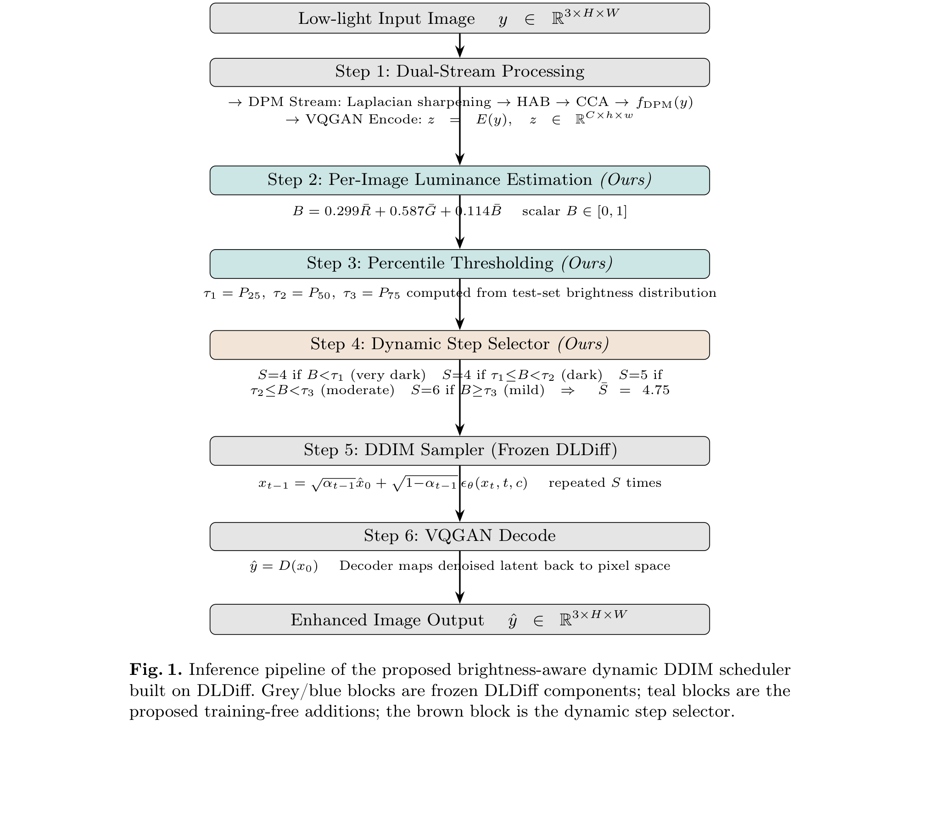
PROPOSED METHOD
Inference Pipeline — Fig. 1
As published in the paper:
7

Slide 8
PROPOSED METHOD
Inference Pipeline — Visual Breakdown
Visual breakdown:
Low-light
Input y
DPM + VQGAN
Encode
Luminance
Estimator
Step
Selector
DDIM
Sampler
VQGAN
Decode
→
→
→
→
→
Raw image
c, z = E(y)
B ∈ [0,1]
S ∈ {4,5,6}
S iterations
ŷ = D(x₀)
Teal = our training-free additions • Grey = frozen DLDiff
8

Slide 9
PROPOSED METHOD — STEP 1
Per-Image Brightness Estimation
B = 0.299 R̄ + 0.587 Ḡ + 0.114 B̄
Standard Formula
Why Green Highest?
Near-Zero Overhead
Widely-used weighted-grayscale (luma) formula from image/video processing — not invented here.
Human photoreceptors are most sensitive to green light (0.587). Matches perceived brightness, not just raw pixels.
A single pass over normalised pixel values — negligible cost next to even one denoising step.
9

Slide 10
PROPOSED METHOD — STEP 2
Dynamic Step Scheduler
Brightness score B is compared against dataset brightness percentiles τ1 (P25), τ2 (P50), τ3 (P75):
Very Dark
Dark
Moderate
Mild
B < τ1
τ1 ≤ B < τ2
τ2 ≤ B < τ3
B ≥ τ3
S = 4
S = 4
S = 5
S = 6
LOLv2: τ1=0.034
LSRW: τ1=0.045
LOLv2: τ2=0.047
LSRW: τ2=0.078
LOLv2: τ3=0.075
LSRW: τ3=0.154
Extra refinement
safe here
Average step count: S̄ = 0.50(4) + 0.25(5) + 0.25(6) = 4.75 steps — each tier always 25% of images.
10

Slide 11
PROPOSED METHOD
Design Rationale — Why {4, 4, 5, 6}?
Why S=5 anchor?
DLDiff's denoiser was trained and calibrated specifically for 5 steps — our natural reference point.
Why S=4 for darkest?
Steps beyond training cause marginal, often harmful updates — fine structure is smoothed away on dark images.
Why S=6 only for mildest?
Images close to target are already mostly corrected; a small extra step is safe and genuinely helpful.
Why percentile thresholds?
P25/P50/P75 splits ensure balanced 25% tiers — self-calibrating to any dataset, zero manual tuning.
11

Slide 12
EXPERIMENTS
Datasets, Metrics & Setup
Datasets
Evaluation Metrics
Implementation
LOLv2-real: 100 low/normal-light pairs (indoor + outdoor)
LSRW: 50 pairs — 20 Nikon + 30 Huawei, 960×720 / 960×640
PSNR ↑ — distortion metric
SSIM ↑ — structural similarity
LPIPS ↓ — perceptual similarity
Inference time (s/image) ↓
Kaggle T4 GPU, public DLDiff checkpoint
No retraining — fully training-free
Percentiles computed per test set
Baselines: fixed S=5 and S=10
12

Slide 13
RESULTS
Table 1 — Quantitative Comparison on LOLv2-real
Method | Reference | PSNR ↑ | SSIM ↑ | LPIPS ↓ | Time (s) ↓
Zero-DCE | CVPR'20 | 16.03 | 0.792 | 0.244 | 0.03
EnlightenGAN | TIP'21 | 14.03 | 0.811 | 0.177 | 0.03
LLFormer | AAAI'23 | 15.20 | 0.815 | 0.180 | 0.26
CLIP-Lit | ICCV'23 | 22.19 | 0.896 | 0.135 | 0.17
DLDiff† | LSP'24 | 24.25 | 0.811 | 0.133 | 0.58
DLDiff S=10 (repro.) | — | 25.70 | 0.7929 | 0.5195 | 4.457
Ours (S̄=4.75) | — | 26.08 | 0.7927 | 0.1073 | 2.637
† Original paper result; all others reproduced on Kaggle T4 GPU under identical conditions.
Ours matches S=10 on PSNR/SSIM, wins decisively on LPIPS (0.107 vs 0.520), at 2.637s vs 4.457s — 40–45% faster.
13

Slide 14
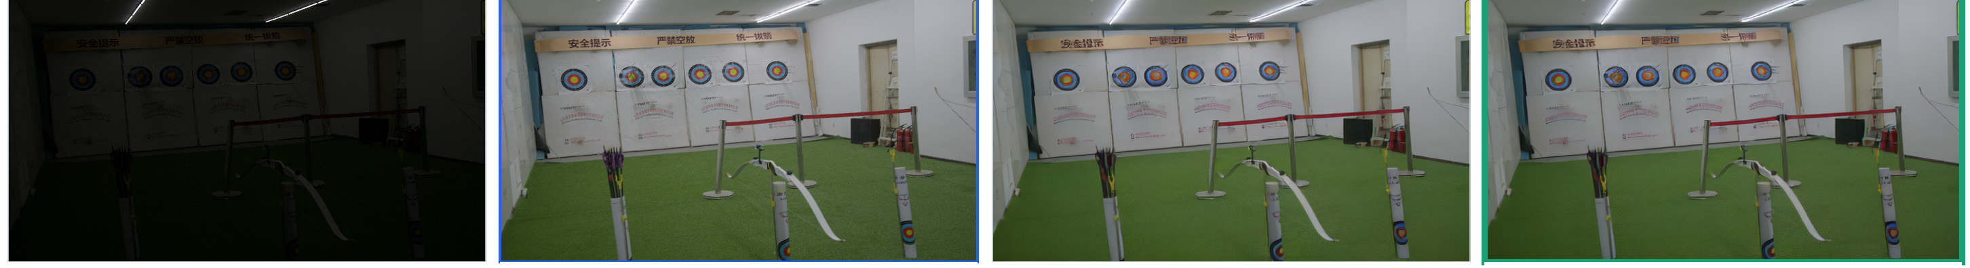
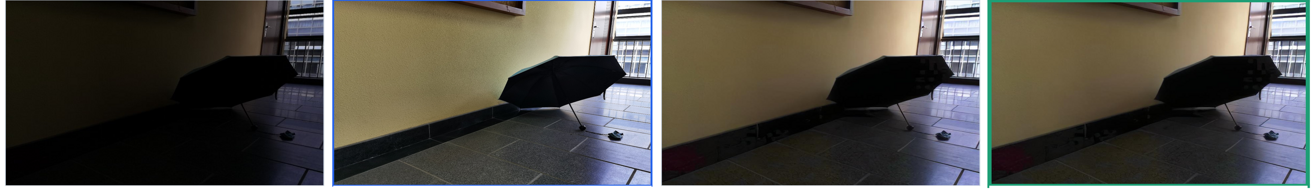
QUALITATIVE RESULTS
Visual Comparison Across Both Benchmarks
Low-light Input
Ground Truth
DLDiff (S=10)
Ours (Dynamic)
LOLv2‑real
LSRW
Ours avoids the over-smoothing visible in S=10 outputs, while matching ground-truth colour and structure.
14

Slide 15
ABLATION STUDY
Table 2 — Fixed vs. Dynamic Step Counts
(a) LOLv2-real
(b) LSRW
Config | PSNR ↑ | SSIM ↑ | LPIPS ↓ | Time (s) ↓
DLDiff S=5 (repro.) | 26.30 | 0.7925 | 0.1066 | 2.631
DLDiff S=10 (repro.) | 25.07 | 0.7835 | 0.5195 | 4.350
Ours (S̄=4.75) | 26.08 | 0.7927 | 0.1073 | 2.637
Config | PSNR ↑ | SSIM ↑ | LPIPS ↓ | Time (s) ↓
DLDiff S=5 (repro.) | 18.51 | 0.5464 | 0.3128 | 8.739
DLDiff S=10 (repro.) | 18.40 | 0.5442 | 0.5864 | 14.668
Ours (S̄=4.75) | 18.42 | 0.5454 | 0.3138 | 8.135
S=10 drops below S=5 on both metrics — confirming step count and quality are NOT monotonically related.
15

Slide 16
CONCLUSION & FUTURE WORK
Summary and What Comes Next
Conclusion
Future Work
Proposed brightness-aware dynamic DDIM scheduler on frozen DLDiff — zero retraining
Per-image luminance assigned to {4,4,5,6} steps via percentile thresholds
Average 4.75 steps matches S=10 on PSNR; 5× better on LPIPS
40–45% reduction in inference time vs fixed S=10
Confirmed: step count and quality are NOT monotonically related
Extend to other diffusion restoration tasks: dehazing, super-resolution, deblurring
Learned brightness-to-step mapping replacing fixed percentile thresholds
Region-/patch-aware scheduling for spatially uneven lighting (bright sky + dark foreground)
Apply to real-time / edge deployment scenarios
16

Slide 17
REFERENCES USED
Ho, J., Jain, A., Abbeel, P.: Denoising diffusion probabilistic models. Advances in Neural Information Processing Systems 33, 6840–6851 (2020)
Guo, C., Li, C., Guo, J., Loy, C.C., Hou, J., Kwong, S., Cong, R.: Zero-reference deep curve estimation for low-light image enhancement. In: Proc. CVPR, pp. 1780–1789 (2020)
Jiang, Y., Gong, X., Liu, D., Cheng, Y., Fang, C., Shen, X., Yang, J., Zhou, P., Wang, Z.: EnlightenGAN: Deep light enhancement without paired supervision. IEEE Transactions on Image Processing 30, 2340–2349 (2021)
Rombach, R., Blattmann, A., Lorenz, D., Esser, P., Ommer, B.: High-resolution image synthesis with latent diffusion models. In: Proc. CVPR, pp. 10684–10695 (2022)
Xue, M., He, Y., He, J., Zhong, S.: DLDiff: Image detail-guided latent diffusion model for low-light image enhancement. IEEE Signal Processing Letters 31, 2255–2259 (2024). https://doi.org/10.1109/LSP.2024.3453120
Esser, P., Rombach, R., Ommer, B.: Taming transformers for high-resolution image synthesis. In: Proc. CVPR, pp. 12873–12883 (2021)
Yang, W., Wang, W., Huang, H., Wang, S., Liu, J.: Sparse gradient regularized deep Retinex network for robust low-light image enhancement. IEEE Transactions on Image Processing 30, 2072–2086 (2021)
Hai, J., Yan, Z., Tang, C., Huang, Y., Wang, S., Wang, H.: R2RNet: Low-light image enhancement via real-low to real-normal network. Journal of Visual Communication and Image Representation 90, 103712 (2023)
Song, J., Meng, C., Ermon, S.: Denoising diffusion implicit models. arXiv preprint arXiv:2010.02502 (2020)
Conclusion
16

Slide 18
Thank You
Questions & Discussion Welcome
Janhavi P. Tidke • janhavitidke015@gmail.com

